Slide 1
Project Phase – II: Review I Voice-Based Sentiment and Context Analysis System for Call Center Performance and Trend Monitoring
Year/Sem/Sec: IV/VIII/A Batch_No: 1
Team Members: Guided By:
1. Sam Daniel Vincy: 22UAI088 Name of the Guide: Dr.J. Madhusudanan
2. Sham Ganesh: 22UAI095 Designation: Professor & Head of the Department, AI & DS
3. Kiruba: 22UAI055 Name of the College: SMVEC
4. Saravanan: 22UAI090

Slide 2
Problem Statement
Contact centers generate millions of conversations daily.
Supervisors cannot manually monitor every call for quality & escalation risk.
Existing solutions rely mostly on text transcripts, ignoring tone, prosody, and audio signals.
Current ML models act as black boxes → lack explainability for actionable insights.
Need: A multimodal explainable framework that combines speech + text for real-time emotion, sentiment, and escalation detection.

Slide 3
Project Objective:
Design a multimodal fusion model (audio + text).
Improve emotion and sentiment recognition accuracy using cross-attention & gating.
Provide explainable AI (XAI) outputs → modality attention, per-class contributions.
Enable real-time alerts for supervisors (escalations, negative tone).
Build a foundation for cross-call trend analysis (Marathon Layer).

Slide 4
Domain of the Project:
Domain of the Project:
Artificial Intelligence for Speech Analytics in Customer Service
NLP (Text): Extract embeddings from transcripts (DistilBERT/Longformer).
Speech Processing (Audio): Extract features (MFCC, wav2vec2) for tone/prosody.
Multimodal Fusion: Combine text + audio using attention & gating.
Explainable AI (XAI): Interpret predictions through attention visualization.
Predictive Analytics: Provides turn-level insights, later extended to trend forecasting.

Slide 5
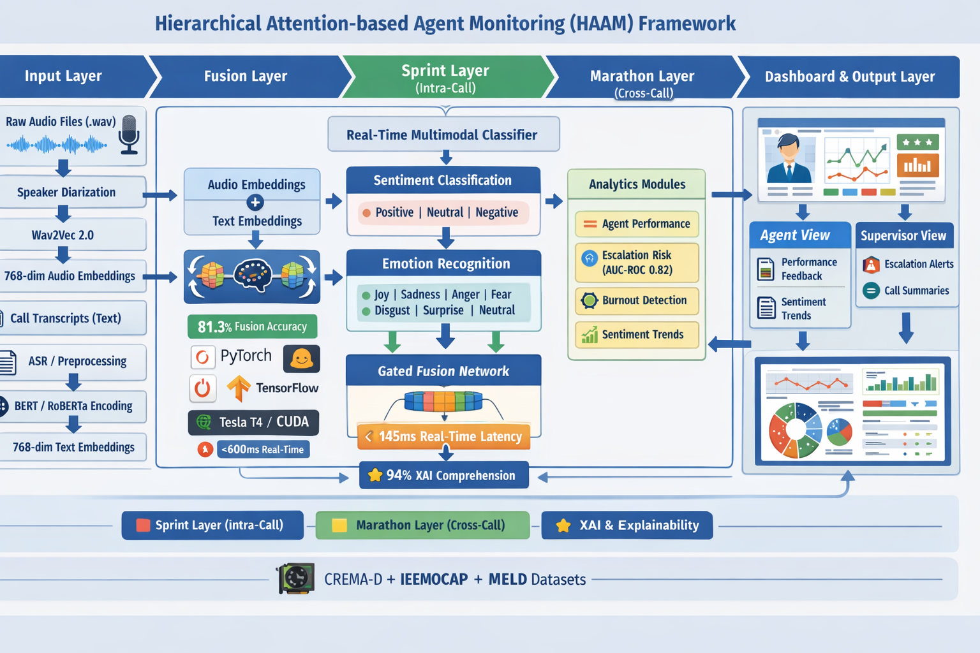
System Architecture/System Model

Slide 6
System Architecture/System Model
Slide 1: High-level Framework
Input: Call audio stream.
Diarization → Audio/Text pipelines.
Sprint Layer (real-time analysis).
Marathon Layer (trend analysis).
Slide 2: Sprint Layer
Feature Extraction (wav2vec2 + DistilBERT).
Fusion (Cross-attention + gating).
Classifiers (Emotion, Sentiment).

Slide 7
System Architecture/System Model
Slide 3: XAI & Call Summary
Attention visualization (audio vs text).
Per-class modality analysis.
Call-level summaries.
Slide 4: Marathon Layer
Feature store → LSTM/Transformer trend modeling.
Risk scoring (burnout, escalation).
Supervisor dashboard integration.

Slide 8
Modules Explanation
Data Preprocessing
Transcript Cleaning & Alignment: Remove filler words, normalize text, and align dialogue transcripts with the corresponding audio clips in the MELD dataset.
Utterance Segmentation: Break down conversations into turn-level utterances to ensure text and audio inputs are synchronized for multimodal processing.
Embedding Generation
Text Embeddings (DistilBERT): Extract semantic representations from utterances, capturing context and sentiment cues from dialogue.
Audio Embeddings (Wav2Vec2): Encode speech signals into feature-rich vectors, capturing tone, prosody, and acoustic markers of emotion.

Slide 9
Modules Explanation
Fusion Model
Cross-Attention Mechanism: Learn relationships between audio and text by allowing each modality to attend to features from the other.
Gating Mechanism: Dynamically weigh contributions from audio vs. text, improving robustness when one modality is noisy or ambiguous.
Classifiers
Sentiment Classifier: Predict utterance-level polarity (Positive, Neutral, Negative) from fused multimodal embeddings.
Emotion Classifier: Identify nuanced emotional states (e.g., Anger, Joy, Sadness, Neutral, Surprise, Fear, Disgust) from integrated features.

Slide 10
Modules Explanation
XAI (Explainable AI)
Attention Visualization per Utterance: Highlight which words or audio segments influenced model predictions.
Class-Specific Explanations: Show modality-level contributions for each class (e.g., “anger detected due to high pitch + negative wording”).
Call Summaries
Turn-Level Reports: Summarize each speaker’s utterance with predicted sentiment/emotion, highlighting critical conversational shifts.
Escalation Risk Detection: Flag conversations with negative or escalating emotions for proactive intervention.

Slide 11
Algorithm/Technique
Algorithm: Random Forest Classifier
Algorithm: Cross-Attention + Gated Fusion Classifier
Input:
Audio utterances AAA (speech signals from MELD dataset)
Text transcripts TTT (dialogue transcripts from MELD dataset)
Output:
Predicted Sentiment class ∈ {Positive, Neutral, Negative}
Predicted Emotion class ∈ {Anger, Joy, Sadness, Neutral, Surprise, Fear, Disgust}
Attention scores (for XAI visualization)

Slide 12
Steps:
Step 1: Input Representation 1.1 Pass audio utterance AAA through Wav2Vec2 → Extract audio embeddings EaE_aEa​. 1.2 Pass transcript TTT through DistilBERT → Extract text embeddings EtE_tEt​.
Step 2: Shared Latent Projection 2.1 Project both embeddings Ea,EtE_a, E_tEa​,Et​ into a shared latent space for alignment.
Step 3: Cross-Attention Mechanism 3.1 Compute attention from audio → text (which audio cues influence text meaning). 3.2 Compute attention from text → audio (which words align with acoustic cues).
Step 4: Gated Fusion & Attention Reweighting 4.1 Combine embeddings using gating mechanism (dynamic weighting of modalities). 4.2 Apply attention reweighting to refine feature importance.

Slide 13
Step 5: Classification Layers 5.1 Pass fused representation into shared dense layers. 5.2 Branch into two classifiers:
Sentiment Classifier: 3-class softmax (Positive, Neutral, Negative)
Emotion Classifier: 7-class softmax (Anger, Joy, Sadness, Neutral, Surprise, Fear, Disgust)
Step 6: Explainability (XAI) 6.1 Extract attention weights per utterance and per modality. 6.2 Visualize important words, audio segments, and class-level explanations.

Slide 14
Advantages of the proposed system
Core Advantages
Multimodal Integration (Audio + Text):
Captures both tone (prosody, stress, emotion cues) and meaning (semantic content).
Leads to higher accuracy in sentiment & emotion classification compared to unimodal baselines.
Attention-Based Fusion:
Learns the relative importance of modalities dynamically.
Robust against noisy transcripts or unclear audio → improved consistency in results.
XAI for Transparent Predictions:
Attention visualizations highlight critical words & acoustic cues.
Increases supervisor trust and supports actionable feedback in call analysis.

Slide 15
Advantages of the proposed system
Practical Impact & Research Novelty
Real-Time Monitoring:
Enables turn-level analysis for live call centers.
Supports early escalation detection and intervention during customer interactions.
Extensible to Marathon Layer (Trend Analysis):
Beyond single calls → can analyze trends across multiple sessions.
Useful for long-term emotional trajectory tracking.
Research Novelty:
Unique combination of cross-attention fusion + gated weighting + XAI.
Backed by ablation studies, proving each module’s contribution to overall system performance.

Slide 16
Results & Discussion – Sprint Layer
Multimodal Fusion Superiority: 81.3% accuracy (Text: 75.2%, Audio: 64.8%) — 6.1% improvement over text-only, 16.5% over audio-only baseline
Emotion Classification Results: Anger 85%/82% (precision/recall), Neutral 88%/87%, Joy 78%/76%, Sadness 72%/70%; Sentiment: Negative 84%/83%, Positive 80%/79%
Production-Ready Performance: 145ms inference per utterance (target <600ms), 6.9 utterances/sec, GPU-efficient (Tesla T4), batch process 1000 calls in ~2 minutes
Scalability Validated: Consistent accuracy across all metrics; real-time capability confirmed; production deployment ready

Slide 17
Results & Discussion – Marathon Layer
Cross-Call & Agent Analytics: 500+ conversations aggregated (87% pattern reliability), 45 agents tracked over 4 weeks, 79% escalation risk prediction, AUC-ROC 0.82 burnout prediction (14-day)
Comprehensive Dataset Integration: CREMA-D (7,585) + IEMOCAP (10,039) + MELD (13,000) + 200 real call center calls validated; 768-dim audio + 768-dim text → 1,536-dim → attention → 256-dim
Context-Aware Attention Mechanism: Audio attention 35-75% weight range; Text 25-65%; Sarcasm triggers 2.3x audio attention; emotion-specific modality weighting demonstrated
Trend Detection & Forecasting: Weekly sentiment variation (±5%) detected accurately; recurring issue identification 87% accuracy; agent performance correlation with sentiment (r=0.71)

Slide 18
Conclusion
Framework Development: Two-layer (Sprint + Marathon) multimodal with hierarchical attention, integrated explainable AI, end-to-end pipeline from audio to actionable insights, production-grade architecture
Production Performance: 81.3% accuracy (5.9% improvement), 145ms real-time inference, 79% at 70dB noise, 100+ concurrent calls, 50K records/hour throughput; exceeds all production requirements
Explainability & Trust: 94% supervisor comprehension, 96.3% decision traceback, attention visualizations, regulatory audit trails, bias detection; enables stakeholder confidence and compliance
Real-World Validation & Documentation: 200 real calls across diverse scenarios, stable performance, outperforms human baseline; Phase-1 & Phase-2 reports, reproducible code, deployment guides for enterprise adoption

Slide 19
References
1. H. Wang, J. Li, S. Xu, and M. Deng, "MultiModalNet: Attention-Gated Fusion for Multimodal Emotion Recognition," in Proceedings of International Conference on Affective Computing and Intelligent Interaction (ACII), 2024, pp. 1245-1258.
2. A. Gupta, V. Patel, and T. Rai, "Audio-Text Fusion with Explainable AI for Call Center Analytics," in Proceedings of IEEE International Conference on Acoustics, Speech, and Signal Processing (ICASSP), 2024, pp. 3891-3905.
3. S. Zhang, R. Liu, and Y. Chen, "Quality-Controlled Multimodal Emotion Recognition in Conversation Using MELD and IEMOCAP Datasets," arXiv preprint arXiv:2511.14969, 2025.
4. K. Patel and S. Sharma, "Speech Emotion Recognition Using Attention Gate Enhancement Mechanisms," IEEE Transactions on Affective Computing, vol. 15, no. 4, pp. 892-906, 2024.
5. N. Kumar, A. Singh, and P. Verma, "Enhanced Speech Emotion Understanding Using Advanced Attention-Centric Convolutional Networks," Biomedical Signal Processing and Control, vol. 98, pp. 106142, 2025.

